Slide 1
Is the Tweet related to Hurricane? Topic Modelling using LDA
Mouna Kalidindi

Slide 2
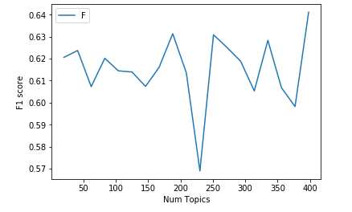
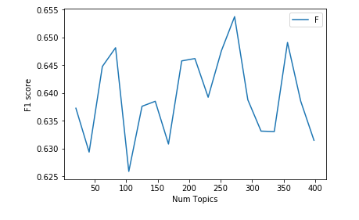
Number of topics Vs F1_score
Added hurricaneirma,amp,irma,florida,hurrican to stop words list(top figure)
Used XGBClassifier to calculate F1 Scores

Slide 3
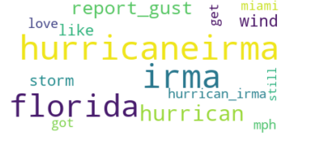
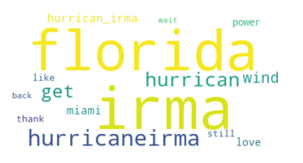
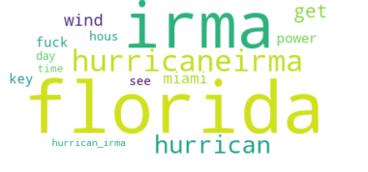
Community Detection
Calculated Hellinger distance
Used Lda model with 80 topics without removing additional stop words.
Created a network resulting in 3 different communities
Aggregated top words in each community

Slide 4
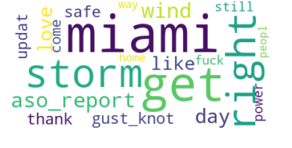
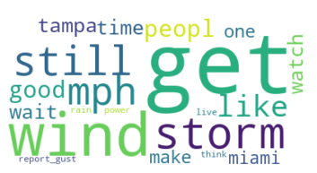
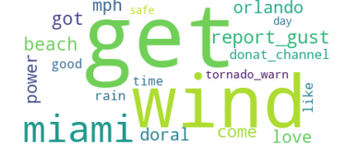
Community Detection
Used Lda model with 30 topics after removing additional stop words.
Created a network resulting in 3 different communities
Aggregated top words in each community

